Slide 1
From individual to average
How to obtain level density and gamma strength function from microscopic calculations
Lecture and exercises for the Oslo Nuclear Physics Summer School 2018
Jørgen E. Midtbø, PhD student, Oslo Cyclotron Laboratory

Slide 2
Outline
The shell model
A word on terminology
What is level density?
What is strength function?
  How to calculate it?
The Brink-Axel hypothesis
A word on the connection to other tools like RAINIER
[Ina’s master thesis presentation at 11 am]
Hands-on exercises

Slide 3
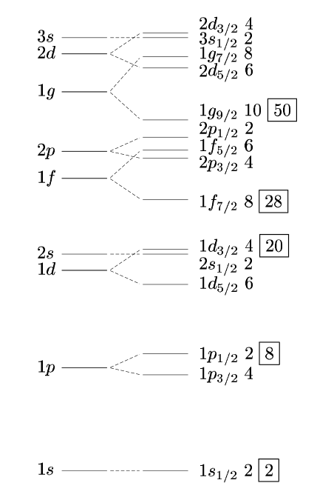
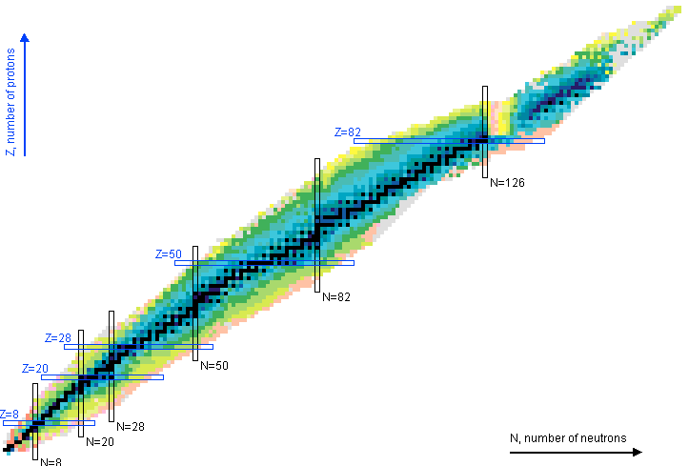
The shell model at a glance

Slide 4
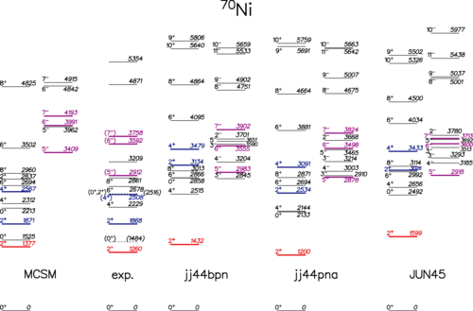
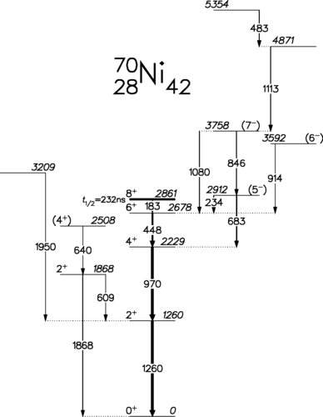
The shell model at a glance
Provides a way to calculate energy levels and transition probabilities in the nucleus
C. J. Chiara et al.
Phys. Rev. C 91, 044309

Slide 5
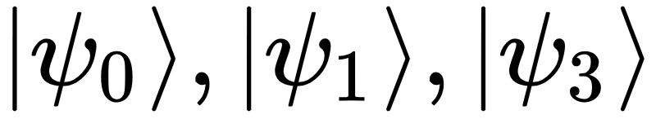
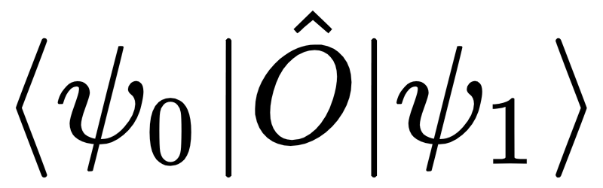
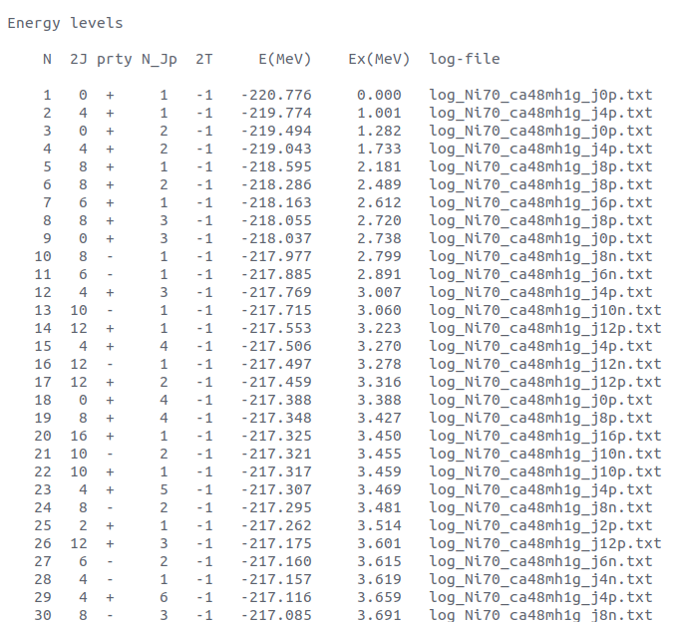
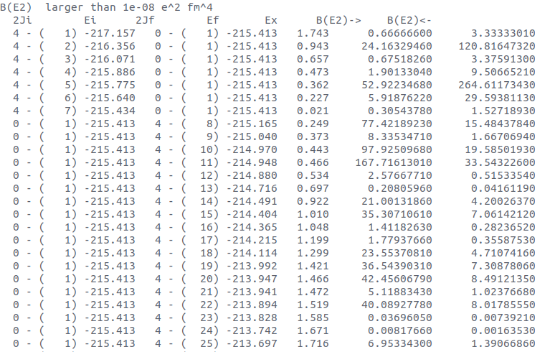
Technically: Wavefunctions & operators
“Under the hood” the shell model code
finds the wave functions of each nuclear level, etc
calculates overlap between the different wavefunctions, etc
The results are reported in a text file:

Slide 6
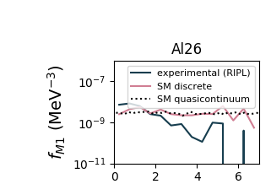
The shell model is just an example
Could just as well have used any other model that provides individual levels and transition probabilities – or even discrete data!

Slide 7
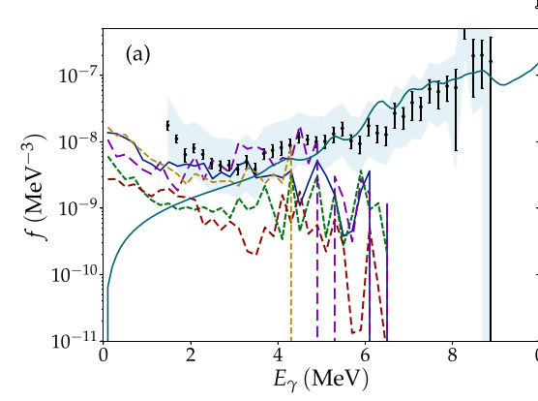
We will concern ourselves with M1 transitions
Source of the low-energy enhancement (“upbend”) in the gamma strength function?
A. C. Larsen, JEM et al., PRC 97, 054329 (2018)

Slide 8
A word on terminology
When talking about transitions, we tend to use many terms interchangeably.
  We speak of transition rate, which equals decay probability per second.
  Decay (or radiative) width is proportional to the transition rate. Also sometimes the loose term decay strength is used interchangeably (not to be confused with the strength function!).
  These are inversely proportional to the lifetime, which is proportional to the half-life.
Concerning energy levels, one sometimes hears state used instead of level. This can lead to confusion, because state density usually refers to the density when counting each magnetic substate.
  We also have to separate between partial and total level density, as we will now see.

Slide 9
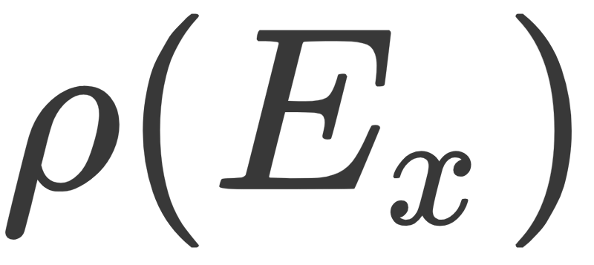

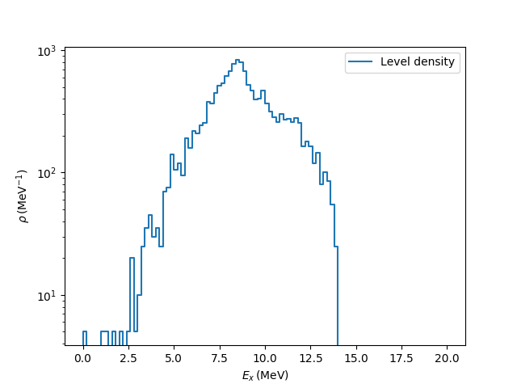
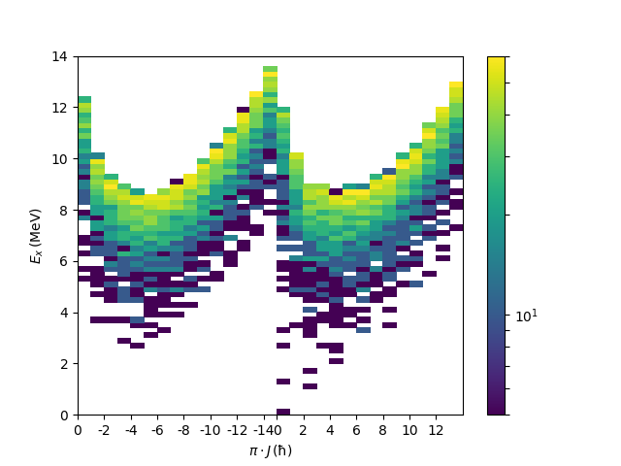
What is: level density
= the number of levels per energy bin.
Can be decomposed into spin and parity, so that

Slide 10

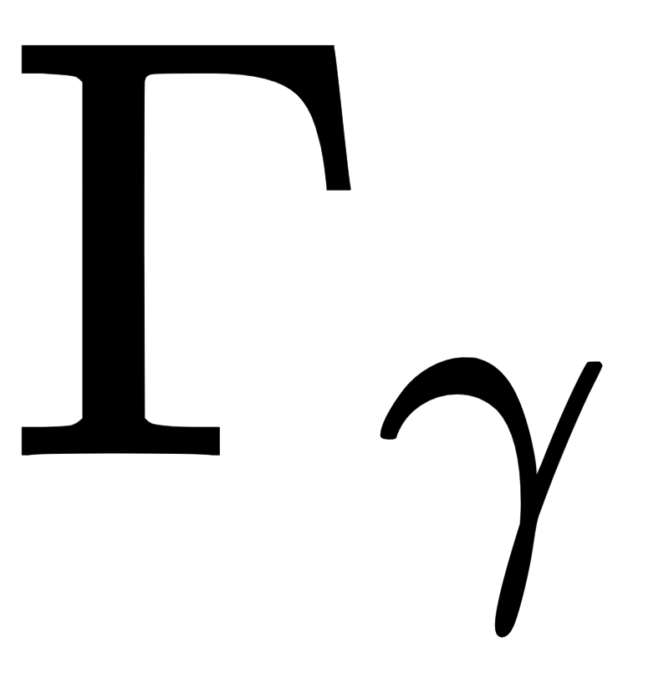
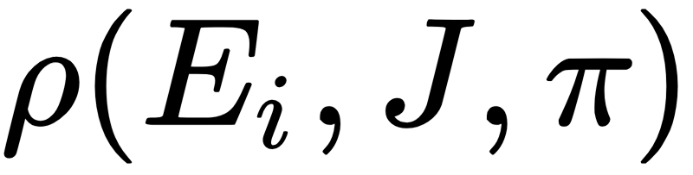
What is: gamma-ray strength function
The definition is
What does it mean?
The gamma-ray strength function (gSF) depends on multipolarity (XL), initial excitation energy (E_{i}), transition energy (E_{𝛾}), spin (J) and parity (𝜋).
is the radiative width (proportional to the decay probability). This is averaged.
is the partial level density of levels with the specific J and 𝜋 at E_{i}.

Slide 11
Why do we want the strength function?
When we take the average of individual transitions, we lose information
Still, it can be useful for many reasons
  The Oslo method cannot resolve individual transitions, and we want to compare to calculations
  At high E_{x}, the calculations probably don’t get the individual levels and transitions right, but the average may still be reasonable
  The properties of the strength function are interesting in itself, in particular the dependence on E_{i}, J and 𝜋 (related to the Brink-Axel hypothesis).
  The strength function is widely used in astrophysical nucleosynthesis research, often based on simple phenomenological formulas that should be checked against more detailed theories.

Slide 12
How to calculate the gSF
To calculate f_{XL}, let’s say with XL=M1, we need to

Slide 13
How to calculate the gSF
To calculate f_{XL}, let’s say with XL=M1, we need to
Pick a bin width, let’s say 0.2 MeV

Slide 14
How to calculate the gSF
2⁺
2⁺
To calculate f_{XL}, let’s say with XL=M1, we need to
Pick a bin width, let’s say 0.2 MeV
Separate out each spin J and parity 𝜋
2⁺

Slide 15
How to calculate the gSF
2⁺
2⁺
To calculate f_{XL}, let’s say with XL=M1, we need to
Pick a bin width, let’s say 0.2 MeV
Separate out each spin J and parity 𝜋
Pick a transition energy (i.e. another excitation energy bin below)
2⁺

Slide 16
How to calculate the gSF
2⁺
2⁺
To calculate f_{XL}, let’s say with XL=M1, we need to
Pick a bin width, let’s say 0.2 MeV
Separate out each spin J and parity 𝜋
Pick a transition energy (i.e. another excitation energy bin below)
Identify all allowed transitions
2⁺
2⁺
3⁺
2⁺
1⁺

Slide 17
How to calculate the gSF
2⁺
2⁺
To calculate f_{XL}, let’s say with XL=M1, we need to
Pick a bin width, let’s say 0.2 MeV
Separate out each spin J and parity 𝜋
Pick a transition energy (i.e. another excitation energy bin below)
Identify all allowed transitions
Take the average of all decay widths
2⁺
2⁺
3⁺
2⁺
1⁺

Slide 18
How to calculate the gSF
2⁺
2⁺
To calculate f_{XL}, let’s say with XL=M1, we need to
Pick a bin width, let’s say 0.2 MeV
Separate out each spin J and parity 𝜋
Pick a transition energy (i.e. another excitation energy bin below)
Identify all allowed transitions
Take the average of all decay widths
Get the partial level density by counting number of J, 𝜋 levels within the initial bin and dividing by bin width.
2⁺
2⁺
3⁺
2⁺
1⁺

Slide 19
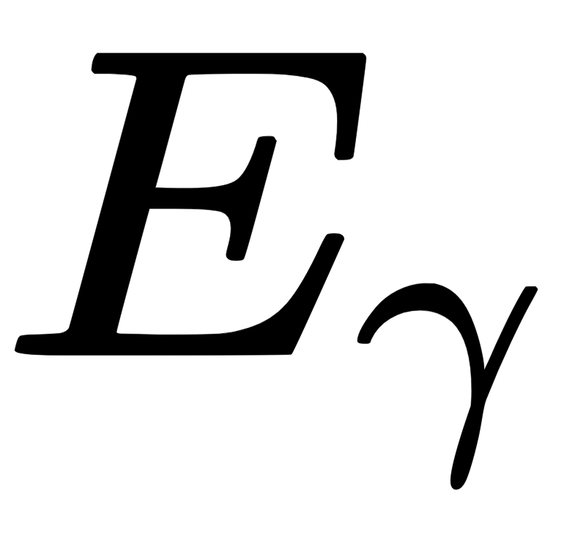
How to calculate the gSF
2⁺
2⁺
To calculate f_{XL}, let’s say with XL=M1, we need to
Pick a bin width, let’s say 0.2 MeV
Separate out each spin J and parity 𝜋
Pick a transition energy (i.e. another excitation energy bin below)
Identify all allowed transitions
Take the average of all decay widths
Get the partial level density by counting number of J, 𝜋 levels within the initial bin and dividing by bin width.
Multiply together and divide by transition energy to the correct power
2⁺
2⁺
3⁺
2⁺
1⁺

Slide 20
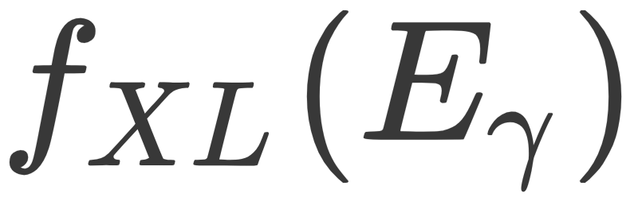
The generalized Brink-Axel hypothesis
The term “generalized Brink-Axel hypothesis” is the assumption that
Or in words: The strength function is approximately independent of excitation energy, spin and parity.
This seems to be reasonable at high enough E_{i}, and is an underlying assumption in the Oslo method.
The best estimate for from microscopic calculations is to take the average over f for each E_{i}, J and 𝜋.

Slide 21
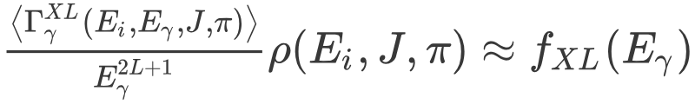
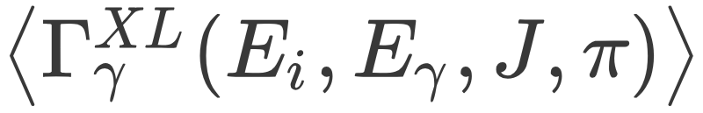
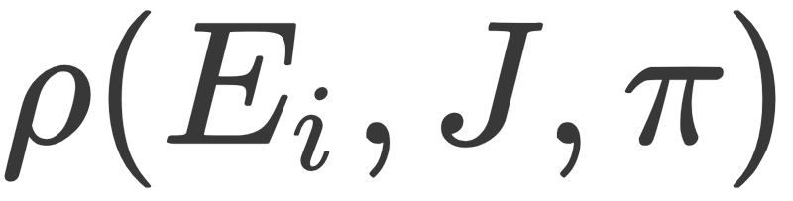
The generalized Brink-Axel hypothesis
How to think about this?
This means that the variation in from E_{i}, J and 𝜋 must be compensated by variation in :

Slide 22
The generalized Brink-Axel hypothesis
How to think about this?
This means that the variation in from E_{i}, J and 𝜋 must be compensated by variation in :

Slide 23
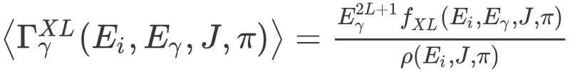
A note on inverting the gSF equation
What if we have the gamma strength function and level density, and want individual transition strengths?
We can invert the equation:
However, this does not tell us about individual transitions. For that, we have to make assumptions about the statistical distribution and make random draws. This is what RAINIER does.
Hence, one way to think about the gamma strength function is as an ingredient of a statistical probability model for the nucleus.

Slide 24
Now it’s your turn !
I’ve prepared the Github repository github.com/jorgenem/oslo_summer_school_2018
It contains
Several different calculation files from KSHELL
A function library shellmodelutilities.py with routines for reading and handling KSHELL files
Example scripts to get you started
*note to self: open the repository and demonstrate the code, especially the shellmodelutilities library*

Slide 25
Exercises
You may use the example scripts as starting points, or write your own.
Hello level density: Choose a calculation file and make a plot of the total level density. Try to turn on and off log scale on the y axis.
Hello strength function: Use the same (or a different) calculation file and make the corresponding strength function.
  Try changing the [spin,parity] selection and see what effect it has.
  Try changing the bin width.
Test Brink-Axel: Make a plot with strength functions based on several different [spin,parity] selections. (I recommend using a for loop.) Do they look similar?
  Modify the code to compare excitation energy regions instead (or in addition!)
Partial level densities: Make a 2D plot of the partial level density as function of excitation energy.
Imitating Oslo method:
  Make a 2D plot of the gSF as function of Ex and Eg.
  The Oslo method is famous for its Ex-Eg matrices, but they are slightly different from what you’ve just plotted. Try to convert the shell model calculations into an Oslo matrix. A useful reference is arXiv:1211.6264.
Test the function spider(): It’s a way to visualize transitions. Test it for E2 transitions. Can you identify the yrast band?
Be creative! And please do tell me if you discover something cool!

